Slide 1
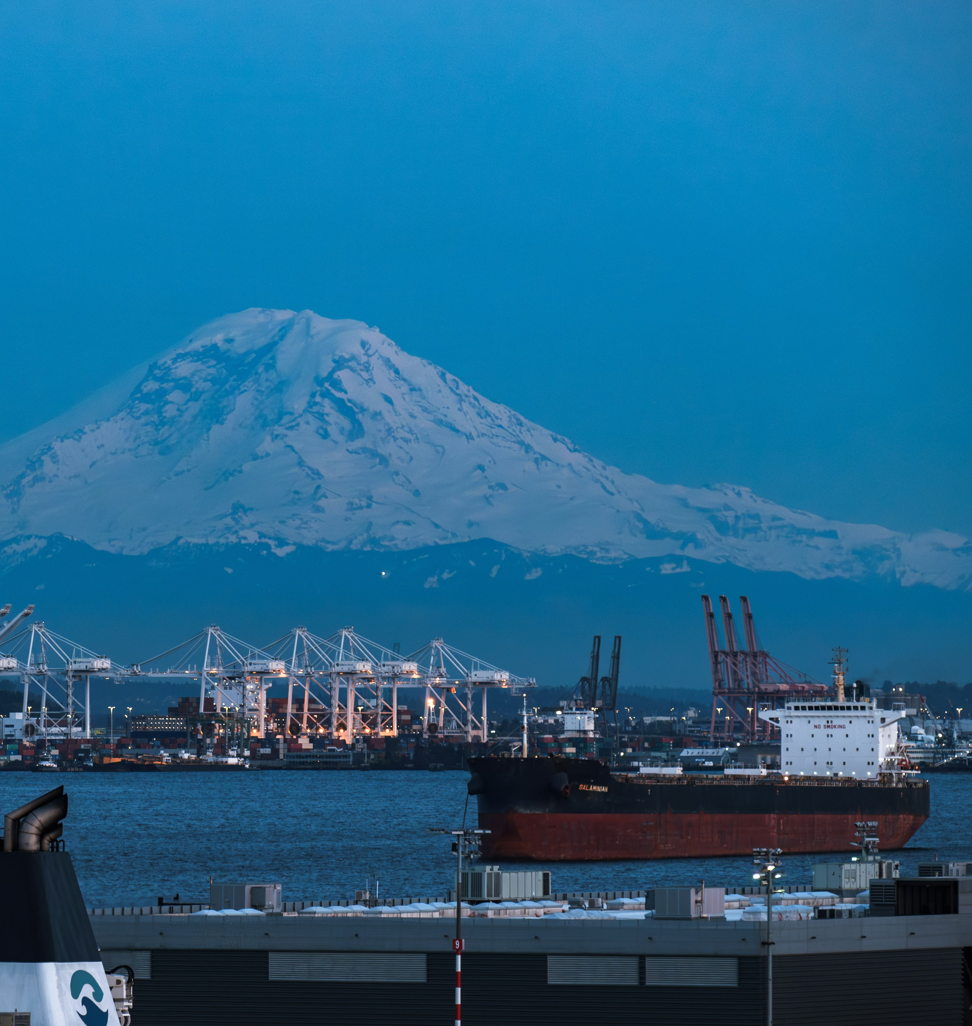
Port Performance In the Pacific Northwest Insights for the Maritime Freight Economy
Adam Wilson
Jake Wagner
Hanouf Alhunayshil
Notes:
This research was supported by the U.S. Department of Agriculture, Agricultural Marketing Service. The findings and conclusions in this publication are those of the authors and should not be construed to represent any official USDA or U.S. Government determination or policy.
High fixed costs, low marginal costs, and economies of scale strongly incentivize capacity maximization in maritime freight.
This has resulted in cargo sharing between carriers since the days of sailing ships and is still the case in the modern maritime economy,
now in the form of Alliances – global agreements between carriers agreeing to share cargo and co-operate vessels.

Slide 2
Port Performance Project
Up-to-date database and analytical platform for principal US maritime ports
Dock-level
Within-port and cross-port comparative analyses
Existing Resources are:
Outdated and/or too aggregated
Paywalled
Dashboard
Static Reports
Curated data

Slide 3
Data
Automatic Identification System
Vessel location, identification, speed and course, status (docked, underway, anchored)
All commercial vessels, typically every minute (>2.5B obs)
Port and Dock Infrastructure
Dock purpose, number of cranes, rail access (number of tracks and service provider)
Semi-structured
Volume Data?
Others?
AIS visualization
Dock infrastructure photo

Slide 4
Northwest Seaport Alliance
NWSPA description
Compare volumes, size, etc to Oakland and LA
Show port-reported/generated KPIs where available
Discuss that ports collect and analyze extensive data already
KPIs, etc

Slide 5
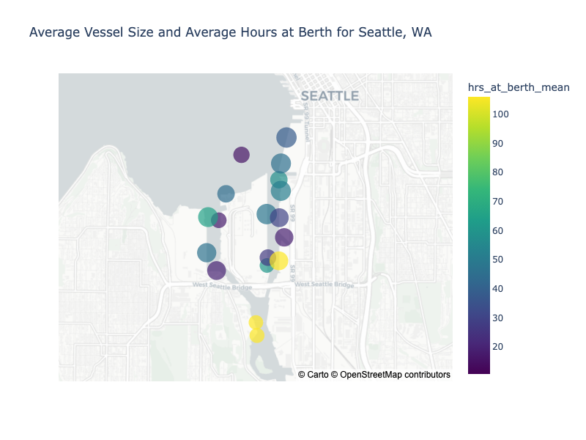
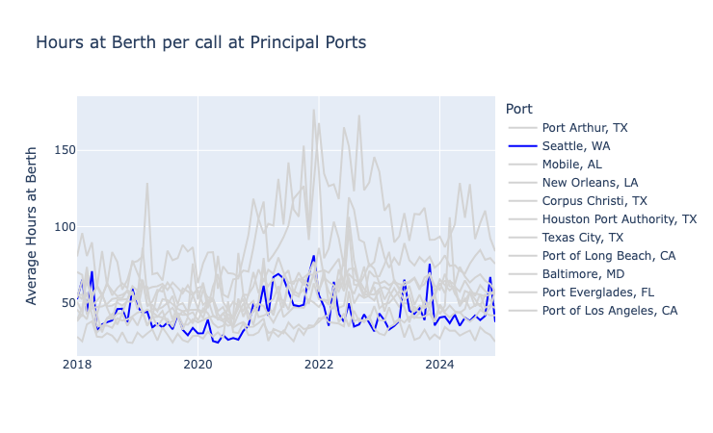
Northwest Seaport Alliance

Slide 6
Initial Insights
Dock infrastructure performance
Comparison to other ports
Comparison SEA vs TAC?

Slide 7
Dashboard Demo

Slide 8
Stakeholder Benefits
Port Authorities
Performance benchmarking and tracking over time
Identification of effective bottlenecks
State and Municipal DOTs
Infrastructure investment planning
ROI tracking
Researchers
Access to granular, up-to-date, tidy data

Slide 9
Next Steps
Real-time AIS data
Historical infrastructure data
Integration with dock-level volumes
Freight data integration?

Slide 10

WSU’s School of Economic Sciences
Data-focused economists and transportation professionals with expertise in:
Research
Planning
Economic Impact Analysis
Applications and Decision-Support Tools
Professional Services
ses.wsu.edu/trg

Slide 11
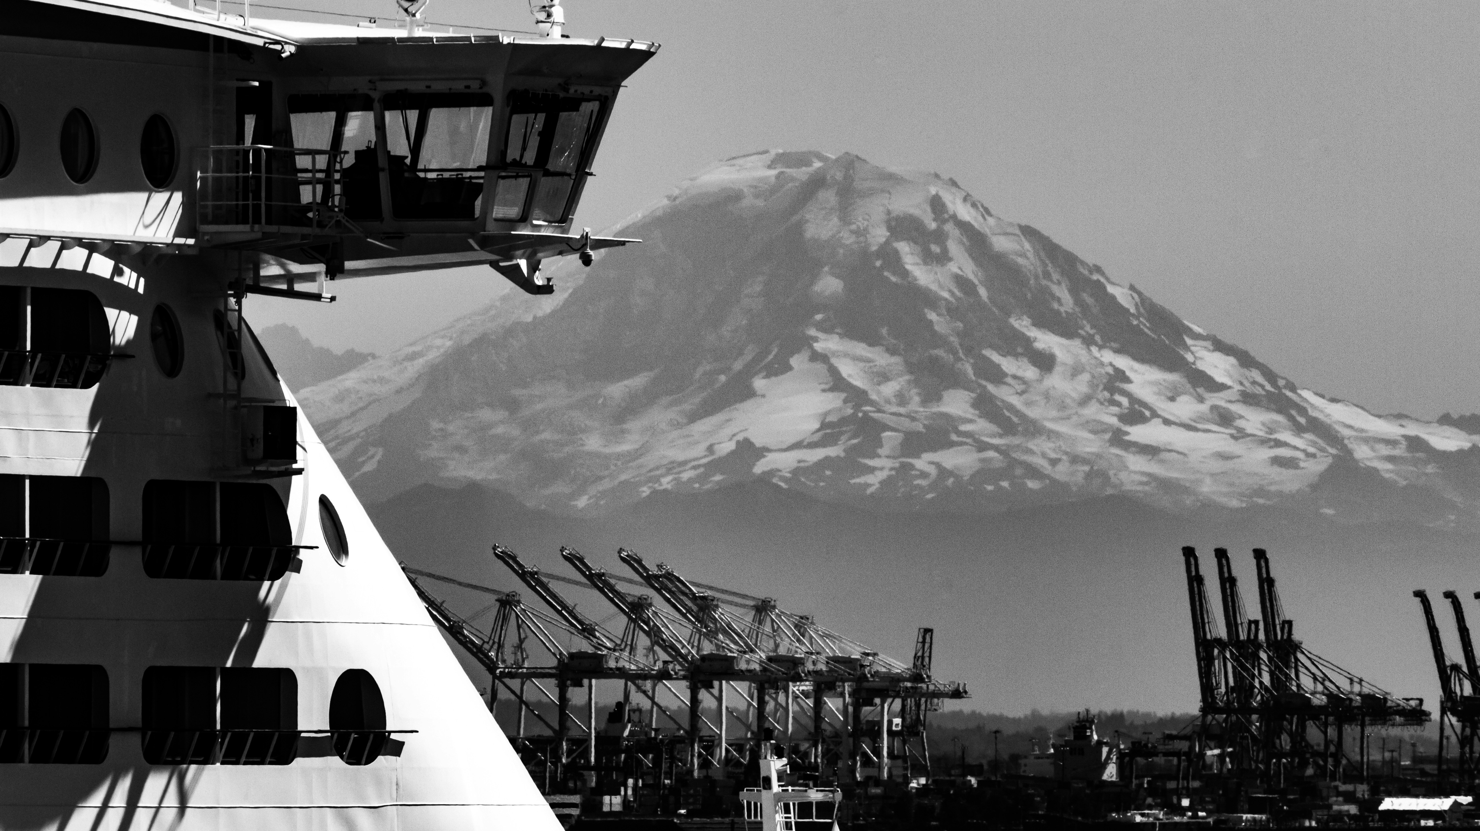
Thank You!

